Slide 1
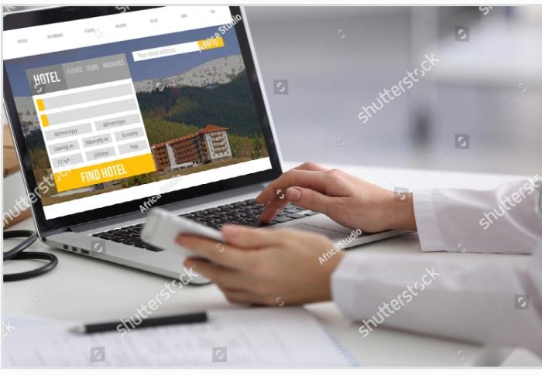
HOTEL RESERVATION SYSTEM
HOTEL RESERVATION SYSTEM

Slide 2
OBJECTIVE
Hotel Reservation System is a java spring boot and mysql which runs on a eclipse. The main feature of this project is manage rooms, Booking, Services, Hotel, Customers and Payments.
The major project in java using spring boot, which is suitable for my final project in edubridge learning center, the main modules of the project is Booking module , Payment module , Rooms module, Customer module and Hotel module, which performs all the operation in their respective domains.
Spring Boot Project on Hotel Reservation System is secured application which run inside the JVM and we have used Eclipse IDE for developing this project.

Slide 3
OBJECTIVE
For developing this Hotel Reservation System in Spring boot, we have used many of the spring boot libraries.
Like for database option we have used JPA, hibernate and for writing custom queries we have used entity manager.
All the dependencies of Hotel Reservation System, we are managing by pom.xml file.

Slide 4
IMPLEMENTATION
System implementation is the most important steps in case of finalizing the approved web system. We need to justify some basic requirement (software & hardware) so that the system will work without having obligation and customers dissatisfactions.

Slide 5
Software Requirement
Operating System: Windows (XP, 7, 8, 8.1) or Mac OSX (Tiger, Leopard, Snow Leopard, Lion, Yosemite).
Web Browser: Google Chrome, Internet Explorer (ver. 8 or later), Mozilla Firefox, Safari (Mac).
Database Management System: MySQL, SQL Server, Microsoft Access, Oracle.
Web Development System: Eclipse (or)Visual Studio 2010 or later, Adobe Dreamweaver, Notepad, and Notepad++.
Others: .NET FRAMEWORK.

Slide 6
Hardware Requirement
RAM: Minimum 1GB or higher.
HDD: Minimum 50 GB.
Processor: Intel Pentium 4 or AMD.
LAN: Version 1.6.6.406(For fixing up client disconnection).

Slide 7
UML DIAGRAM
Class Diagram.
Use Case Diagram.
Data Flow Diagram.

Slide 8
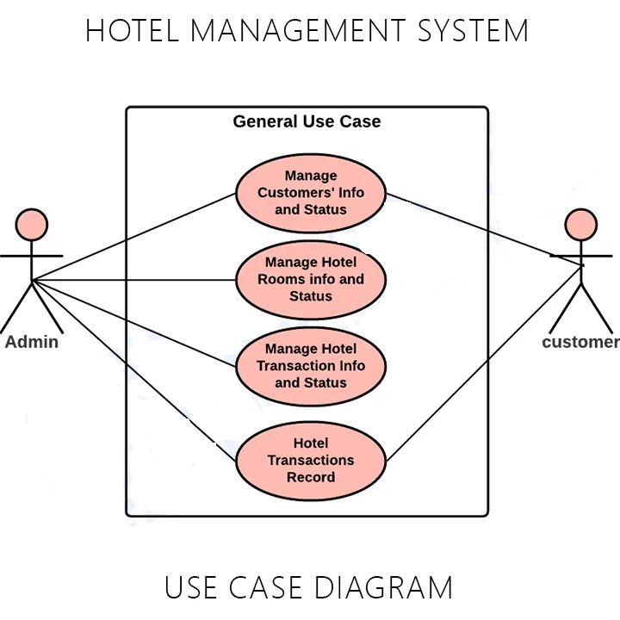
USE CASE DIAGRAM

Slide 9
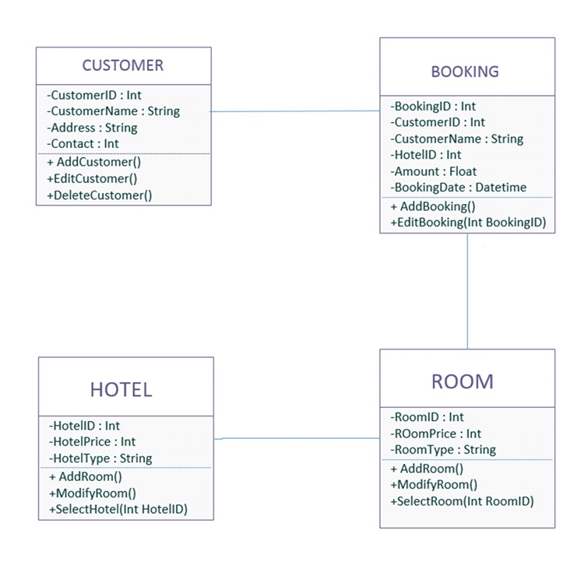
CLASS DIAGRAM

Slide 10
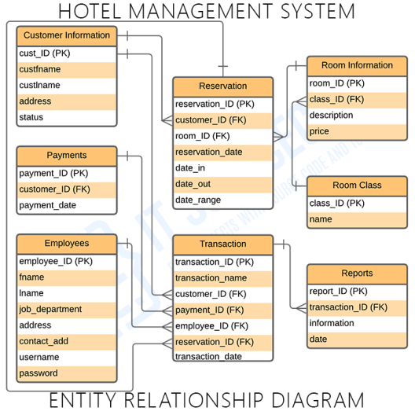
ENTITY RELATIONSHIP DIAGRAM

Slide 11
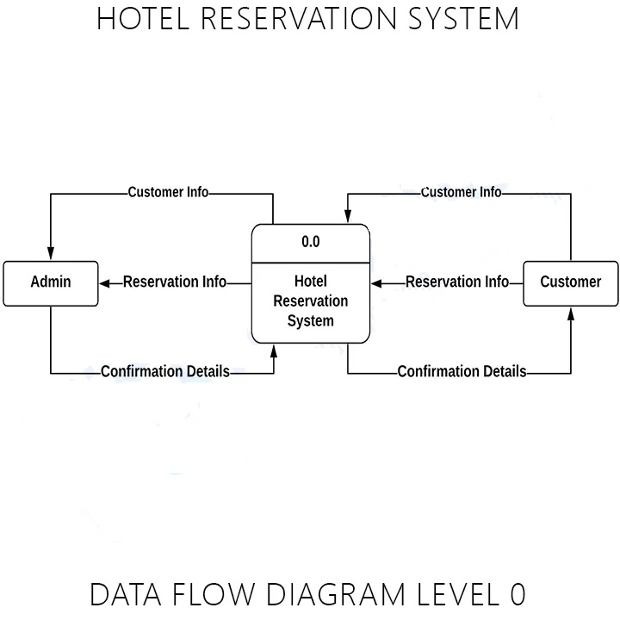
DATA FLOW DIAGRAM

Slide 12
DFD-Level 0
In this data flow diagram you will see the general process done in Hotel Reservation System monitoring. This will also serve as a guide as you go through the deeper processes of the Hotel Reservation System data flow diagrams. As you see, when you build the levels of data flow diagrams, the connections of the transactions and data also broadens and gets more specific.

Slide 13
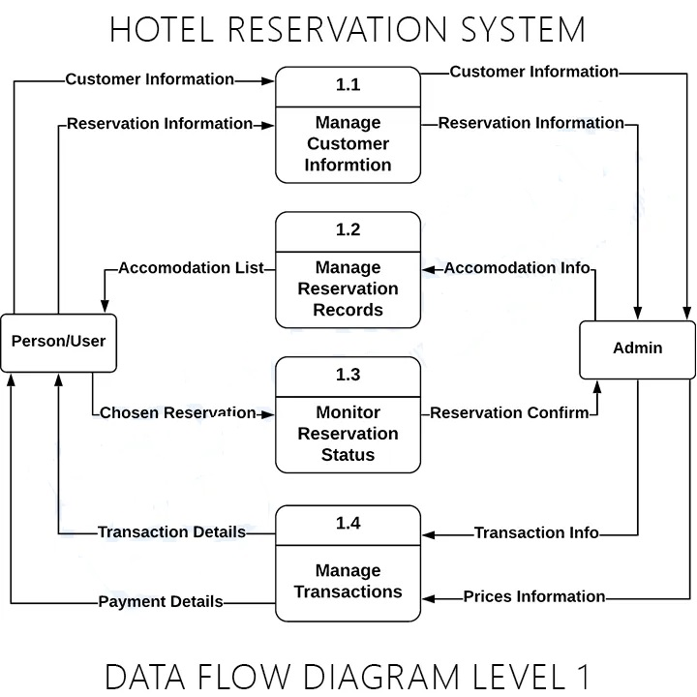
DFD level 1

Slide 14
DFD level 1
In this level, the system must display or reveal further processing information. The following are essential data to accommodate:
Reservation Records
Customer Information
Date of Reservation
Transaction Records
Revenue
Employee Records
These procedures require information such as record of customers, reservations, payment, transaction and revenue from which served as the bases for the Hotel admin to manage the Hotel Reservation System.

Slide 15
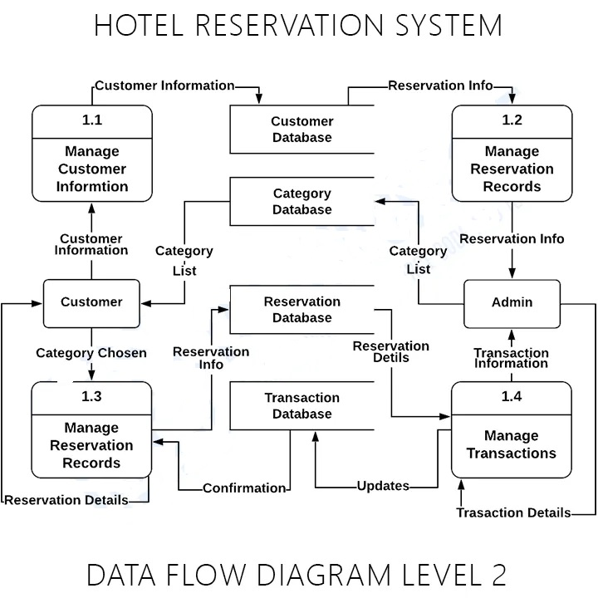
DFD level 2

Slide 16
DFD level 2
Finally, after figuring the processes given in the system, the user will now have their request being processed. The Processes that the system should prioritize are as follows:
Manage Customer Information
Manage Reservation Records
Checks Date of Reservations
Update Reservation Status
Monitor Transaction

Slide 17
MODULES
Rooms module: We can manage all the operations to Rooms from this module.
Booking module: this module is normally developed for managing the booking operations.
Services module: all the operations related to services will be managed by Services.
Hotel module: this module manages hotel functionalities.
Customers module: Customers module performs all the create, update and delete operations of customers.
Payment module: it manages all the functionalities of payments.

Slide 18
TEST PLAN
Test Case 001:
Test Title: Eazy Booking Icon
Test Procedures: Click on the icon.
Test Data: Users need to click on the icon bar.
Expected Result: It will redirect to the system home page.
Test Case 002:
Test Title: Customer & Staff Login.
Test Procedures: Type username & password.
Test Data: Username & password must be in alphanumeric. Otherwise system will show error (ex. Please enter valid alphanumeric data).
Expected Result: It will redirect to login page.

Slide 19
TEST PLAN
Test Case 003:
Test Title: Sign Up
Test Procedures: Click sign up page.
Test Data: Input customer’s information and click on the button “SIGN UP”.
Expected Result: It will register new customer.
Test Case 004
Test Title: Search.
Test Procedures: Type destinations name with selecting check-in and check-out.
Test Data: Valid destinations name with date.
Expected Result: System will search according to customer’s choice.

Slide 20
TEST PLAN
Test Case 005
Test Title: Manage Booking.
Test Procedures: Click on the link “Manage Booking”.
Test Data: Add, Edit, Del & Save button.
Expected Result: Staffs can edit, add and Del individual customers booking records.
Test Case 006:
Test Title: Username & Password
Test Procedures: Enter customers or staffs valid username (Upper Case and Lower Case) and password (Alphanumeric).
Test Data: Invalid password will show the warning message (Please Enter Valid Password).
Expected Result: The system will follow the validation pattern.

Slide 21
TEST PLAN
Test Case 007:
Test Title: View Booking Cancel Button
Test Procedures: Customers need to sign in and can cancel the booking when they press cancel button.
Test Data: Cancel their particular booking record.
Expected Result: Will cancel their booking records from database.
Test Case 008:
Test Title: Change Search
Test Procedures: Customers can change their search according to changing their check in,check out and destinations.
Test Data: Click on the button “Change Search” from hotels availability page.
Expected Result: Customers can select their new check in and check out date with destinations.

Slide 22
CONCLUSION
The system is having some benefits for customers too. In home page customers can put their email address or phone number for downloading the booking apps directly on their phone.
The application will work for both OS Platform (IOS & Android). By this customers can book by using this application. Besides, customers can also book online without registering into the system. Again, customers no need to worry for payment.
But for reservation they need to key in their credit card details for verification purposes. It will not charge them promptly. So, overall this system will give the customers a better user friendly environment to book online.

Slide 23


